Slide 1



Noida Institute of Engineering and Technology, Greater Noida
Graphs & File Structure
Unit:5
Data Structure
Megha Gupta
Assistant Professor
Computer Science and Engineering
Course Details (Ex: B Tech 3rd Sem)

Slide 2
Syllabus
UNIT-5
Graphs: Terminology used with Graph, Data Structure for Graph Representations: Adjacency
Matrices, Adjacency List, Adjacency. Graph Traversal: Depth First Search and Breadth First
Search, Connected Component, Spanning Trees, Minimum Cost Spanning Trees: Prims and Kruskal algorithm. Transitive Closure and Shortest Path algorithm: Warshal Algorithm and Dijikstra Algorithm.
File Structures

Slide 3
Contents
Topics | Duration (in Hours)
Terminology used with Graph | 1
Data Structure for Graph Representations: Adjacency Matrices, Adjacency List, Adjacency. | 1
Depth First Search | 1
Breadth First Search | 1
Minimum Cost Spanning Trees | 1
Prims Algorithm | 1
Kruskal algorithm | 1
Dijikstra Algorithm | 2
Warshall Algorithm | 1

Slide 4
Objective of Unit
Objective of the course is to make students able to:
To learn what a graph is and how it is used.
To implement the graph abstract data type using multiple internal representations.
To see how graphs can be used to solve a wide variety of problems

Slide 5
Course Outcome
CO5: Implementation of Graphs and perform various operations on these data structure.

Slide 6
CO-PO Mapping
Sr. No | Course Outcome | PO1 | PO2 | PO3 | PO4 | PO 5 | PO 6 | PO7 | PO8 | PO 9 | PO1 0 | PO1 1 | PO1 2
1 | CO 5 | 3 | 3 | 3 | 3 | 3 | 2 | 1 | 1 | 3 | 1 | 2 | 1

Slide 7
CO-PSO Mapping
Sr. No | Course Outcome | PSO 1 | PSO 2 | PSO 3 | PSO 4
1 | CO 5 | 2 | 2 | 3 | 2

Slide 8
Prerequisite and Recap
Introduction to graphs
BFS
DFS
Prims
Kruskal
Dijkstra Algo
Warshal Algo

Slide 9
Graphs (CO5)
Topic mapping with Course Outcome
Topic | CO1 | CO2 | CO3 | CO4 | CO5
Graphs | - | - | - | - | 3

Slide 10
Graphs
Introduction to Graphs
Graph is a non-linear data structure. It contains a set of points known as nodes (or vertices) and a set of links known as edges (or Arcs). Here edges are used to connect the vertices. A graph is defined as follows...
Graph is a collection of vertices and arcs in which vertices are connected with arcs
or
Graph is a collection of nodes and edges in which nodes are connected with edges
Generally, a graph G is represented as G = ( V , E ), where V is set of vertices and E is set of edges.

Slide 11
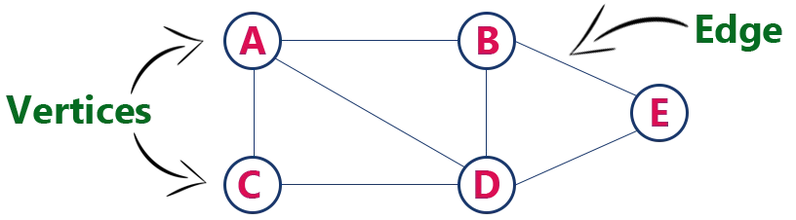
Graphs
Example
The following is a graph with 5 vertices and 6 edges. This graph G can be defined as G = ( V , E )
Where V = {A,B,C,D,E} and E = {(A,B),(A,C)(A,D),(B,D),(C,D),(B,E), (E,D)}.

Slide 12
Graphs
Graph Terminology
We use the following terms in graph data structure...
Vertex
Individual data element of a graph is called as Vertex. Vertex is also known as node. In above example graph, A, B, C, D & E are known as vertices.
Edge
An edge is a connecting link between two vertices. Edge is also known as Arc. An edge is represented as (startingVertex, endingVertex). For example, in above graph the link between vertices A and B is represented as (A,B). In above example graph, there are 7 edges (i.e., (A,B), (A,C), (A,D), (B,D), (B,E), (C,D), (D,E)).

Slide 13
Graphs
Edges are three types.
Undirected Edge - An undirected egde is a bidirectional edge. If there is undirected edge between vertices A and B then edge (A , B) is equal to edge (B , A).
Directed Edge - A directed egde is a unidirectional edge. If there is directed edge between vertices A and B then edge (A , B) is not equal to edge (B , A).
Weighted Edge - A weighted egde is a edge with value (cost) on it.

Slide 14
Graphs
Undirected Graph
A graph with only undirected edges is said to be undirected graph.
Directed Graph
A graph with only directed edges is said to be directed graph.
Mixed Graph
A graph with both undirected and directed edges is said to be mixed graph.
End vertices or Endpoints
The two vertices joined by edge are called end vertices (or endpoints) of that edge.

Slide 15
Graphs
Origin
If a edge is directed, its first endpoint is said to be the origin of it.
Destination
If a edge is directed, its first endpoint is said to be the origin of it and the other endpoint is said to be the destination of that edge.
Adjacent
If there is an edge between vertices A and B then both A and B are said to be adjacent. In other words, vertices A and B are said to be adjacent if there is an edge between them.

Slide 16
Graphs
Incident
Edge is said to be incident on a vertex if the vertex is one of the endpoints of that edge.
Outgoing Edge
A directed edge is said to be outgoing edge on its origin vertex.
Incoming Edge
A directed edge is said to be incoming edge on its destination vertex.
Degree
Total number of edges connected to a vertex is said to be degree of that vertex.

Slide 17
Graphs
Indegree
Total number of incoming edges connected to a vertex is said to be indegree of that vertex.
Outdegree
Total number of outgoing edges connected to a vertex is said to be outdegree of that vertex.
Parallel edges or Multiple edges
If there are two undirected edges with same end vertices and two directed edges with same origin and destination, such edges are called parallel edges or multiple edges.

Slide 18
Graphs
Self-loop
Edge (undirected or directed) is a self-loop if its two endpoints coincide with each other.
Simple Graph
A graph is said to be simple if there are no parallel and self-loop edges.
Path
A path is a sequence of alternate vertices and edges that starts at a vertex and ends at other vertex such that each edge is incident to its predecessor and successor vertex.

Slide 19
Graphs
Graph Representations
Graph data structure is represented using following representations...
Adjacency Matrix
Incidence Matrix
Adjacency List

Slide 20
Graphs
Adjacency Matrix
In this representation, the graph is represented using a matrix of size total number of vertices by a total number of vertices.
That means a graph with 4 vertices is represented using a matrix of size 4X4.
In this matrix, both rows and columns represent vertices.
This matrix is filled with either 1 or 0.
Here, 1 represents that there is an edge from row vertex to column vertex and 0 represents that there is no edge from row vertex to column vertex.

Slide 21
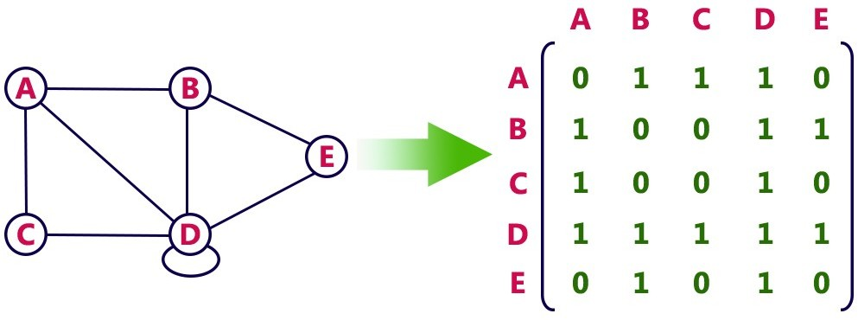
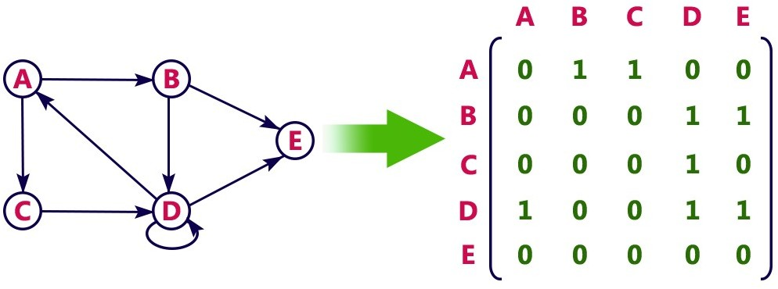
Undirected graph representation...
Graphs
Directed graph representation...

Slide 22
Graphs
Incidence Matrix
In this representation, the graph is represented using a matrix of size total number of vertices by a total number of edges.
That means graph with 4 vertices and 6 edges is represented using a matrix of size 4X6.
In this matrix, rows represent vertices and columns represents edges. This matrix is filled with 0 or 1 or -1.

Slide 23
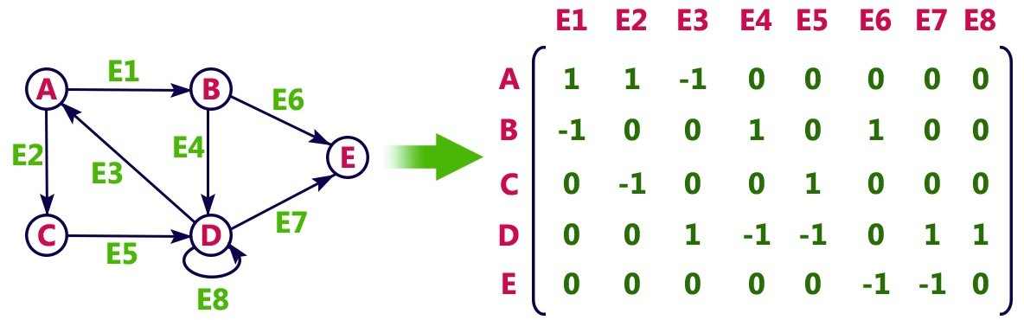
Graphs
Incidence Matrix
Here, 0 represents that the row edge is not connected to column vertex
1 represents that the row edge is connected as the outgoing edge to column vertex and -1 represents that the row edge is connected as the incoming edge to column vertex.
For example, consider the following directed graph representation...

Slide 24
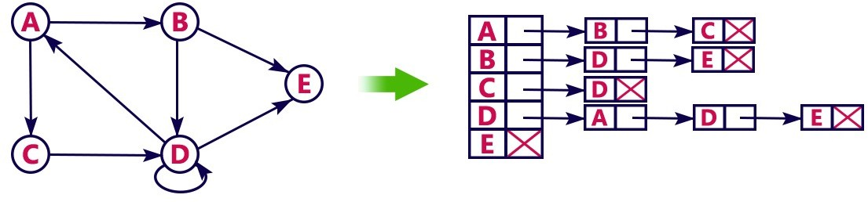
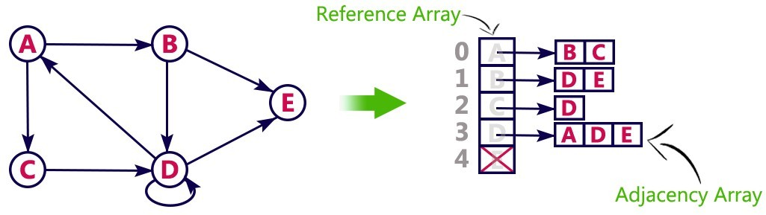
Graphs
Adjacency List
In this representation, every vertex of a graph contains list of its adjacent vertices.
For example, consider the following directed graph representation implemented using linked list...
This representation can also be implemented using an array as follows..

Slide 25
Graphs
Graph Traversal – DFS
Graph traversal is a technique used for a searching vertex in a graph. The graph traversal is also used to decide the order of vertices is visited in the search process. A graph traversal finds the edges to be used in the search process without creating loops. That means using graph traversal we visit all the vertices of the graph without getting into looping path.
There are two graph traversal techniques and they are as follows...
DFS (Depth First Search)
BFS (Breadth First Search)

Slide 26
Graphs
DFS (Depth First Search)
DFS traversal of a graph produces a spanning tree as final result. Spanning Tree is a graph without loops.
We use Stack data structure with maximum size of total number of vertices in the graph to implement DFS traversal.

Slide 27
Graphs
DFS (Depth First Search)
We use the following steps to implement DFS traversal...
Step 1 - Define a Stack of size total number of vertices in the graph.
Step 2 - Select any vertex as starting point for traversal. Visit that vertex and push it on to the Stack.
Step 3 - Visit any one of the non-visited adjacent vertices of a vertex which is at the top of stack and push it on to the stack.

Slide 28
Graphs
Step 4 - Repeat step 3 until there is no new vertex to be visited from the vertex which is at the top of the stack.
Step 5 - When there is no new vertex to visit then use back tracking and pop one vertex from the stack.
Step 6 - Repeat steps 3, 4 and 5 until stack becomes Empty.
Step 7 - When stack becomes Empty, then produce final spanning tree by removing unused edges from the graph

Slide 29
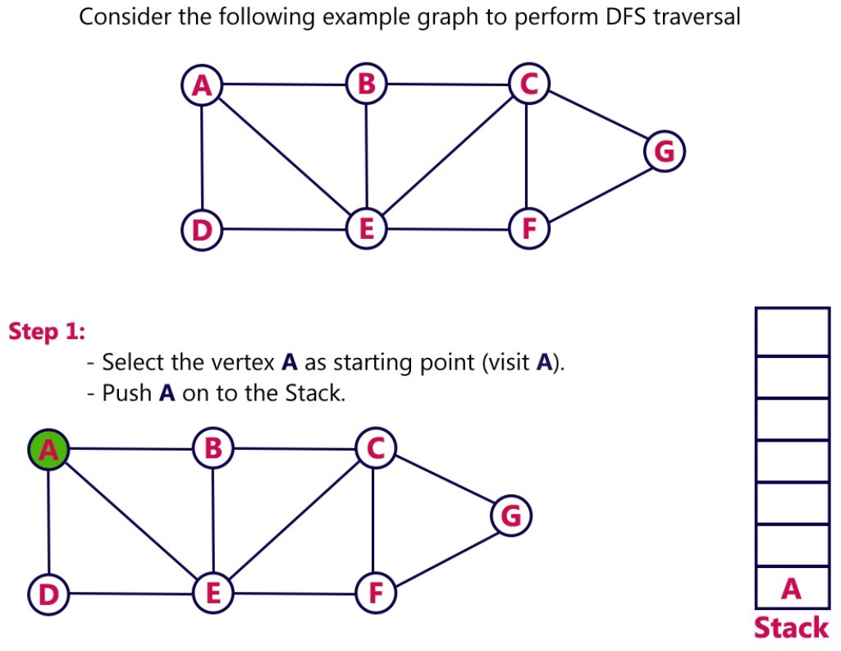
Example
Graphs

Slide 30
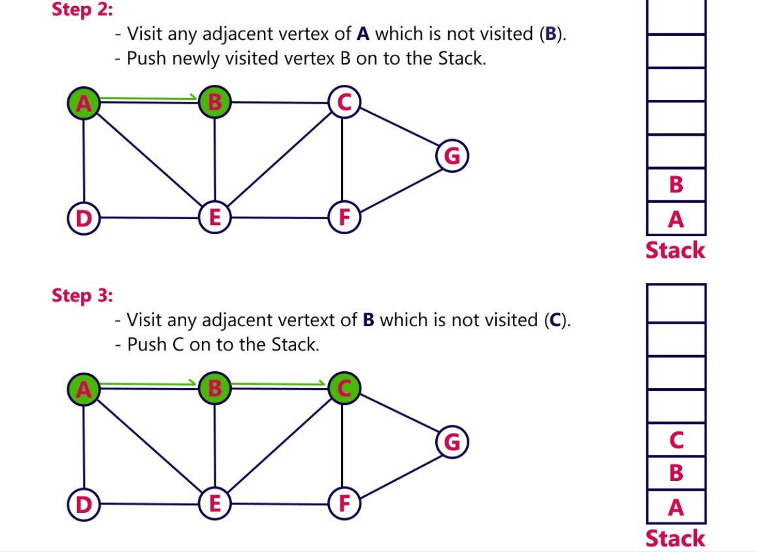
Graphs

Slide 31
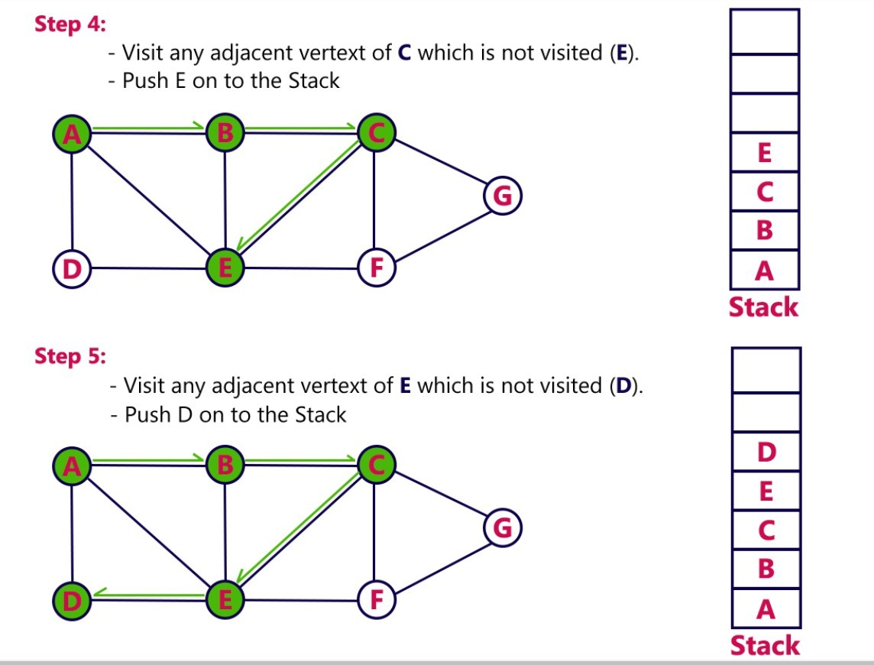
Graphs

Slide 32
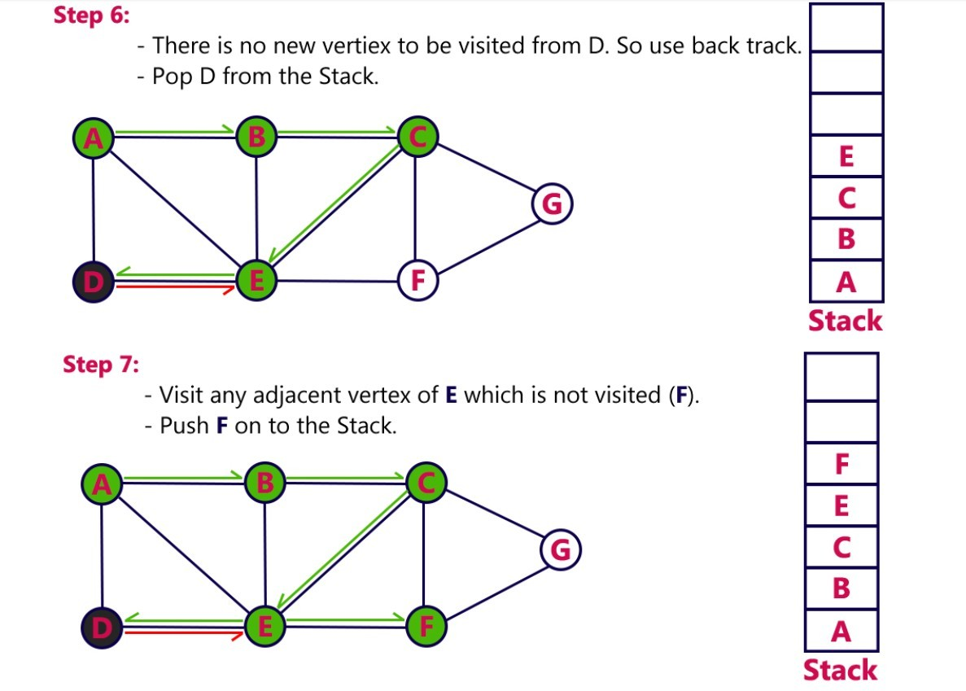
Graphs

Slide 33
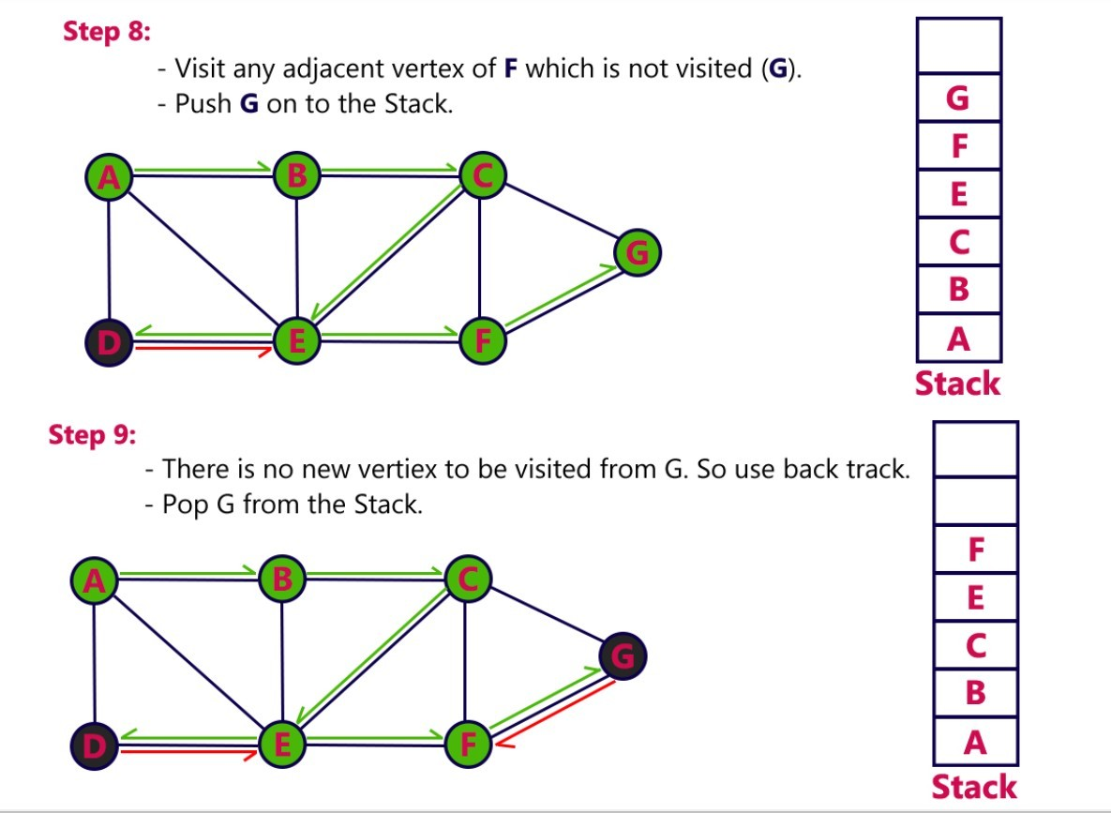
Graphs

Slide 34
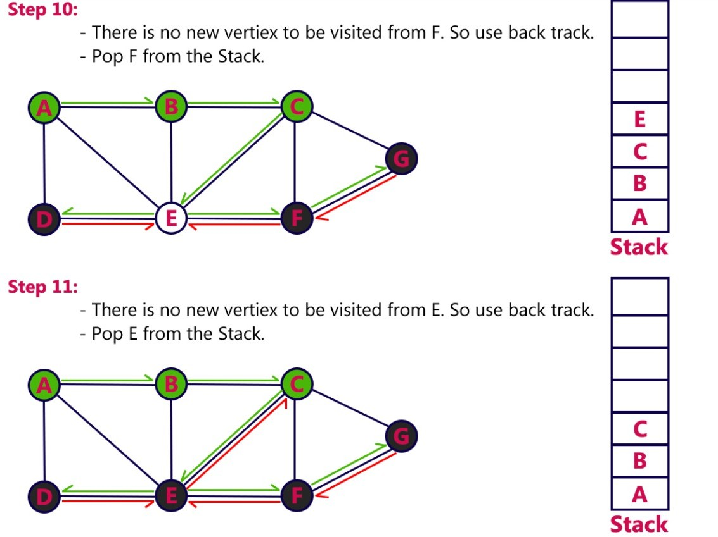
Graphs

Slide 35
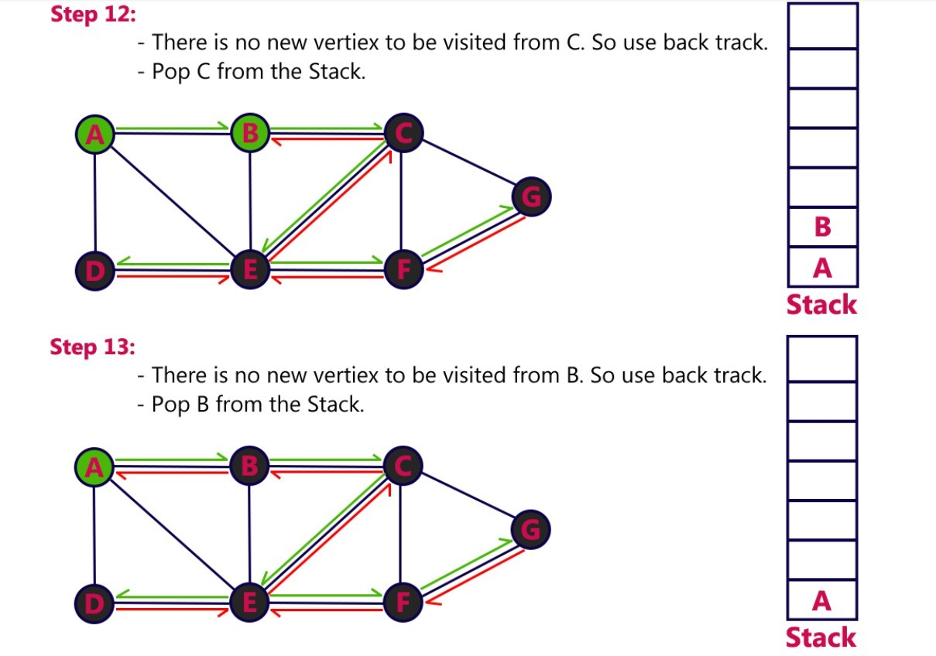
Graphs

Slide 36
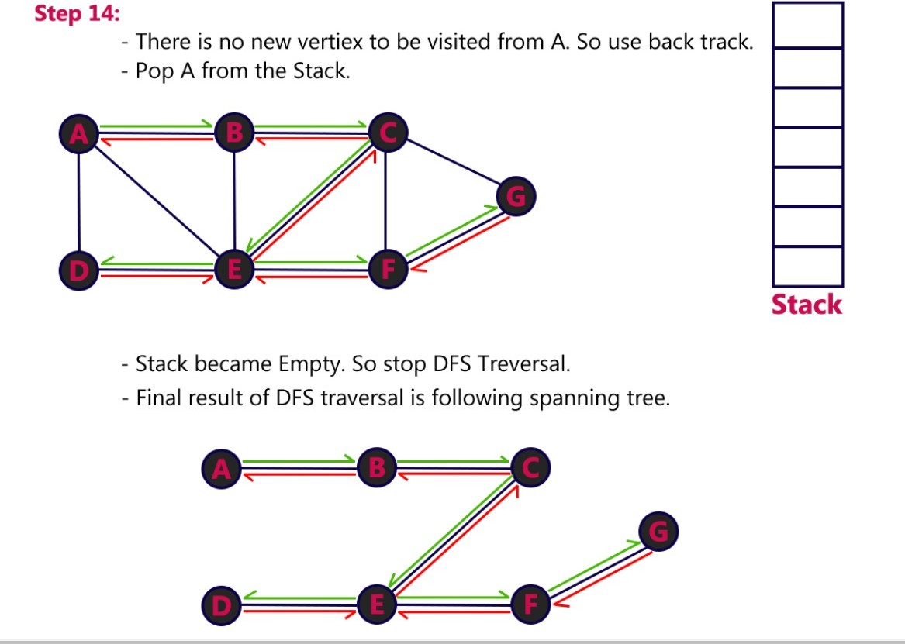
Graphs

Slide 37
Graphs
Graph Traversal – BFS
Graph traversal is a technique used for searching a vertex in a graph. The graph traversal is also used to decide the order of vertices is visited in the search process.
A graph traversal finds the edges to be used in the search process without creating loops. That means using graph traversal we visit all the vertices of the graph without getting into looping path.
There are two graph traversal techniques and they are as follows...
DFS (Depth First Search)
BFS (Breadth First Search)

Slide 38
Graphs
BFS (Breadth First Search)
BFS traversal of a graph produces a spanning tree as final result. Spanning Tree is a graph without loops. We use Queue data structure with maximum size of total number of vertices in the graph to implement BFS traversal.
We use the following steps to implement BFS traversal...
Step 1 - Define a Queue of size total number of vertices in the graph.
Step 2 - Select any vertex as starting point for traversal. Visit that vertex and insert it into the Queue.

Slide 39
Graphs
Step 3 - Visit all the non-visited adjacent vertices of the vertex which is at front of the Queue and insert them into the Queue.
Step 4 - When there is no new vertex to be visited from the vertex which is at front of the Queue then delete that vertex.
Step 5 - Repeat steps 3 and 4 until queue becomes empty.
Step 6 - When queue becomes empty, then produce final spanning tree by removing unused edges from the graph.

Slide 40
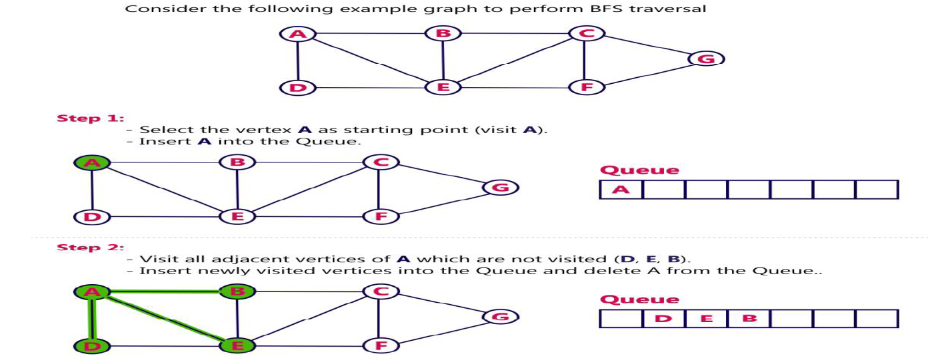
Graphs

Slide 41
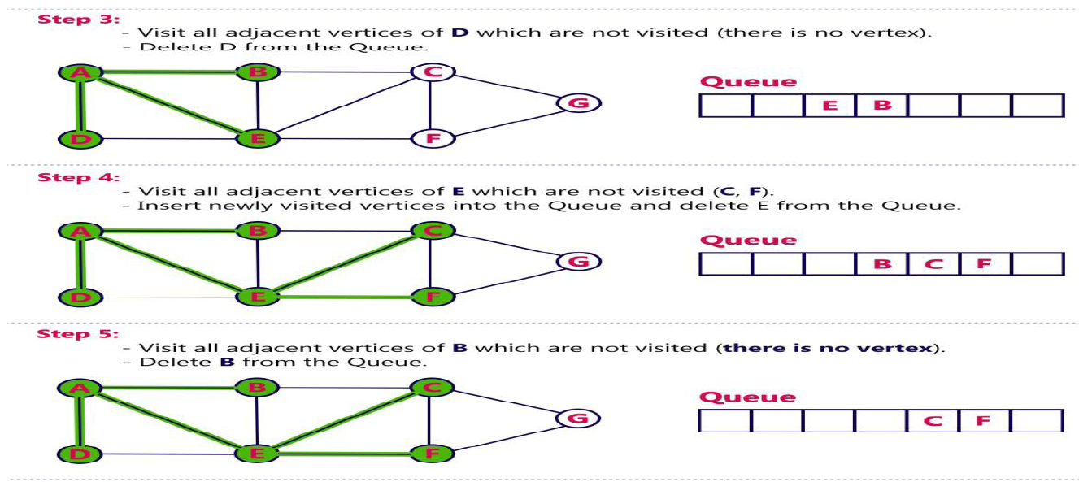
Graphs

Slide 42
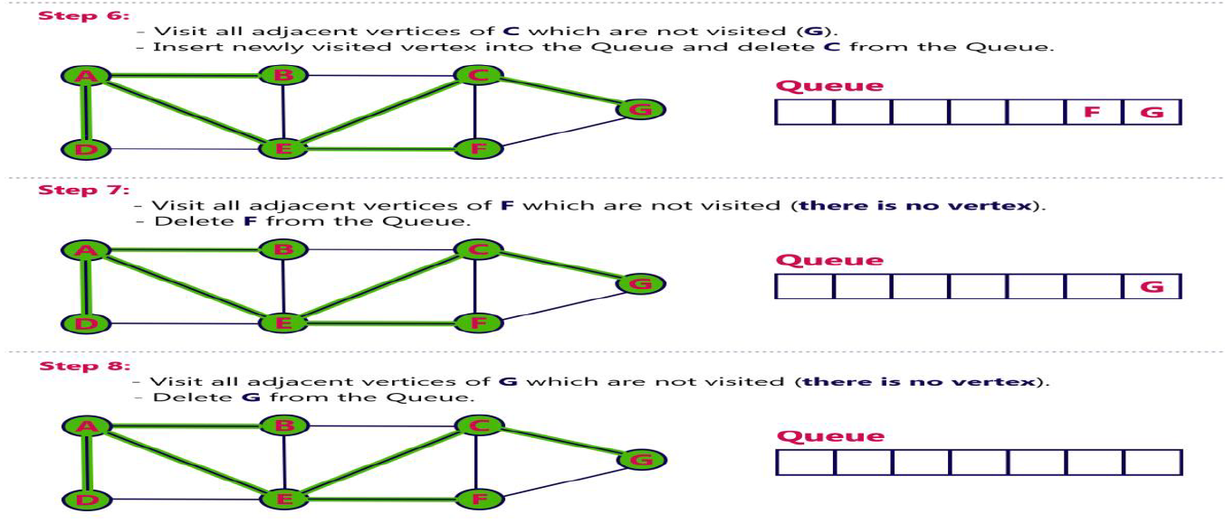
Graphs

Slide 43
Graphs
Queue became Empty, So, stop the BFS process.
Final result of BFS is a Spanning tree as shown below

Slide 44
Graphs
Spanning Tree
Spanning tree can be defined as a sub-graph of connected, undirected graph G that is a tree produced by removing the desired number of edges from a graph.
In other words, Spanning tree is a non-cyclic sub-graph of a connected and undirected graph G that connects all the vertices together.
A graph G can have multiple spanning trees.

Slide 45
S. No. | Parameters | BFS | DFS
1 | Stands for | BFS stands for Breadth First Search. | DFS stands for Depth First Search.
2 | Data Structure | BFS(Breadth First Search) uses Queue data structure for finding the shortest path. | DFS(Depth First Search) uses Stack data structure.
3 | Definition | BFS is a traversal approach in which we first walk through all nodes on the same level before moving on to the next level. | DFS is also a traversal approach in which the traverse begins at the root node and proceeds through the nodes as far as possible until we reach the node with no unvisited nearby nodes.
4 | Technique | BFS can be used to find a single source shortest path in an unweighted graph because, in BFS, we reach a vertex with a minimum number of edges from a source vertex. | In DFS, we might traverse through more edges to reach a destination vertex from a source.
5 | Conceptual Difference | BFS builds the tree level by level. | DFS builds the tree sub-tree by sub-tree.
6 | Approach used | It works on the concept of FIFO (First In First Out). | It works on the concept of LIFO (Last In First Out).

Slide 46
S. No. | Parameters | BFS | DFS
7 | Suitable for | BFS is more suitable for searching vertices closer to the given source. | DFS is more suitable when there are solutions away from source.
9 | Time Complexity | The Time complexity of BFS is O(V + E) when Adjacency List is used and O(V^2) when Adjacency Matrix is used, where V stands for vertices and E stands for edges. | The Time complexity of DFS is also O(V + E) when Adjacency List is used and O(V^2) when Adjacency Matrix is used, where V stands for vertices and E stands for edges.
10 | Visiting of Siblings/ Children | Here, siblings are visited before the children. | Here, children are visited before the siblings.
12 | Backtracking | In BFS there is no concept of backtracking. | DFS algorithm is a recursive algorithm that uses the idea of backtracking
13 | Applications | BFS is used in various applications such as bipartite graphs, shortest paths, etc. | DFS is used in various applications such as acyclic graphs and topological order etc.
14 | Memory | BFS requires more memory. | DFS requires less memory.
15 | Optimality | BFS is optimal for finding the shortest path. | DFS is not optimal for finding the shortest path.
17 | Speed | BFS is slow as compared to DFS. | DFS is fast as compared to BFS.
18 | When to use? | When the target is close to the source, BFS performs better. | When the target is far from the source, DFS is preferable.

Slide 47
Spanning Trees
A spanning tree of a graph is just a subgraph that contains all the vertices and is a tree.
A graph may have many spanning trees.
Graph A Some Spanning Trees from Graph A

Slide 48
Spanning Trees
Complete Graph All 16 of its Spanning Trees

Slide 49
Graphs
Spanning Tree
Minimum Spanning Tree
There can be weights assigned to every edge in a weighted graph.
However, A minimum spanning tree is a spanning tree which has minimal total weight.
In other words, minimum spanning tree is the one which contains the least weight among all other spanning tree of some particular graph.

Slide 50
Graphs
In this section of the tutorial, we will discuss the algorithms to calculate the shortest path between two nodes in a graph.
There are two algorithms which are being used for this purpose.
Prim's Algorithm
Kruskal's Algorithm

Slide 51
Graphs
Prim's Algorithm
Prim's Algorithm is used to find the minimum spanning tree from a graph. Prim's algorithm finds the subset of edges that includes every vertex of the graph such that the sum of the weights of the edges can be minimized.
Prim's algorithm starts with the single node and explore all the adjacent nodes with all the connecting edges at every step. The edges with the minimal weights causing no cycles in the graph got selected.

Slide 52
Graphs
Prim's Algorithm
The algorithm is given as follows.
Algorithm
Step 1: Select a starting vertex
Step 2: Repeat Steps 3 and 4 until there are fringe vertices
Step 3: Select an edge e connecting the tree vertex and fringe vertex that has minimum weight
Step 4: Add the selected edge and the vertex to the minimum spanning tree T
[END OF LOOP]
Step 5: EXIT

Slide 53
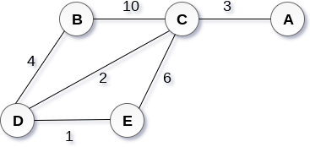
Graphs
Example :
Construct a minimum spanning tree of the graph given in the following figure by using prim's algorithm.
Solution
Step 1 : Choose a starting vertex B.
Step 2: Add the vertices that are adjacent to A. the edges that connecting the vertices are shown by dotted lines.

Slide 54
Graphs
Step 3: Choose the edge with the minimum weight among all. i.e. BD and add it to MST. Add the adjacent vertices of D i.e. C and E.
Step 3: Choose the edge with the minimum weight among all. In this case, the edges DE and CD are such edges. Add them to MST and explore the adjacent of C i.e. E and A.
Step 4: Choose the edge with the minimum weight i.e. CA. We can't choose CE as it would cause cycle in the graph.
The graph produces in the step 4 is the minimum spanning tree of the graph shown in the above figure.
The cost of MST will be calculated as; cost(MST) = 4 + 2 + 1 + 3 = 10 units.

Slide 55
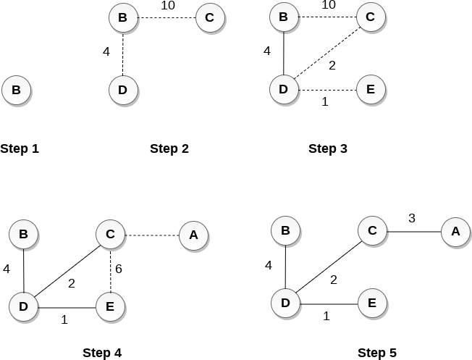
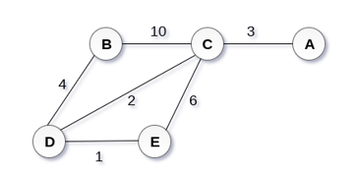
Graphs

Slide 56
Graphs
Kruskal's Algorithm
Kruskal's Algorithm is used to find the minimum spanning tree for a connected weighted graph.
The main target of the algorithm is to find the subset of edges by using which, we can traverse every vertex of the graph.
Kruskal's algorithm follows greedy approach which finds an optimum solution at every stage instead of focusing on a global optimum.

Slide 57
Graphs
The Kruskal's algorithm is given as follows.
Algorithm
Step 1: Create a forest in such a way that each graph is a separate tree.
Step 2: Create a priority queue Q that contains all the edges of the graph.
Step 3: Repeat Steps 4 and 5 while Q is NOT EMPTY

Slide 58
Graphs
Step 4: Remove an edge from Q
Step 5: IF the edge obtained in Step 4 connects two different trees, then Add it to the forest (for combining two trees into one tree).
ELSE
Discard the edge
Step 6: END

Slide 59
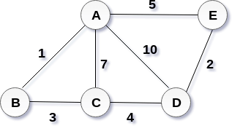
Graphs
Example :
Apply the Kruskal's algorithm on the graph given as follows.
Solution:
the weight of the edges given as:
Edge | AE | AD | AC | AB | BC | CD | DE
Weight | 5 | 10 | 7 | 1 | 3 | 4 | 2

Slide 60
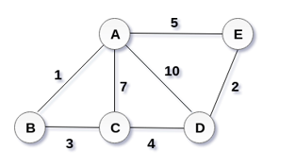
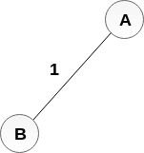
Graphs
Sort the edges according to their weights.
Edge | AB | DE | BC | CD | AE | AC | AD
Weight | 1 | 2 | 3 | 4 | 5 | 7 | 10
Start constructing the tree; Add AB to the MST;
Add DE to the MST;

Slide 61
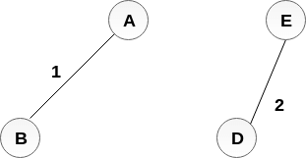
Add BC to the MST;
Graphs

Slide 62
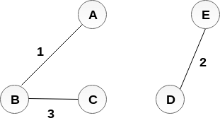
Graphs
The next step is to add AE, but we can't add that as it will cause a cycle.
The next edge to be added is AC, but it can't be added as it will cause a cycle.
The next edge to be added is AD, but it can't be added as it will contain a cycle.
Hence, the final MST is the one which is shown in the step 4. the cost of MST = 1 + 2 + 3 + 4 = 10.

Slide 63
Shortest Path Problems
What is shortest path ?
shortest length between two vertices for an unweighted graph:
smallest cost between two vertices for a weighted graph:
B
B
210
A
A
450
60
190
C
unweighted graph
C
weighted graph
200
130
D
D
E
E

Slide 64
Shortest Path Problems
How can we find the shortest route between two points on a map?
Model the problem as a graph problem:
Road map is a weighted graph:
vertices = cities
edges = road segments between cities
edge weights = road distances
Goal: find a shortest path between two vertices (cities)

Slide 65
Shortest Path Problems
Input:
Directed graph G = (V, E)
Weight function w : E → R
Weight of path p = ⟨v₀, v₁, . . . , v_{k}⟩
Shortest-path weight from u to v:
δ(u, v) = min w(p) : u v if there exists a path from u to v
∞ otherwise
Shortest path u to v is any path p such that w(p) = δ(u, v)
t
x
3
6
9
3
4
s
0
2
1
2
7
5
3
5
11
6
y
z
p

Slide 66
Variants of Shortest Paths
Single-source shortest path
G = (V, E) ⇒ find a shortest path from a given source vertex s to each vertex v ∈ V
Single-destination shortest path
Find a shortest path to a given destination vertex t from each vertex v
Reverse the direction of each edge ⇒ single-source
Single-pair shortest path
Find a shortest path from u to v for given vertices u and v
Solve the single-source problem
All-pairs shortest-paths
Find a shortest path from u to v for every pair of vertices u and v

Slide 67
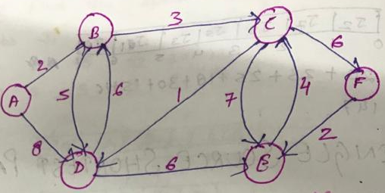
Shortest Path Algorithm
Find the single source shortest path from the vertex A.
Priority queue → A B C D E F
0 ∞ ∞ ∞ ∞ ∞
Solution set (S)= ϕ
Extract min(Queue) = A S = S U {A}
= {A}

Slide 68
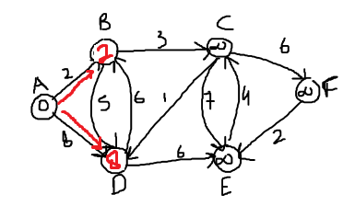
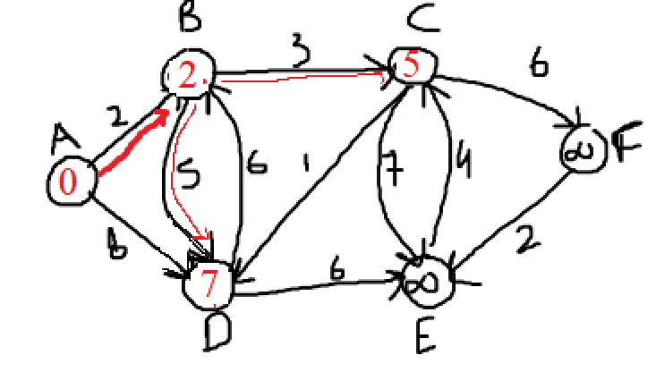
Shortest Path Algorithm
Priority queue → B C D E F
2 ∞ 8 ∞ ∞
Solution set (S)= {A}
Extract min(Queue) = B S = S U {B}
= {A,B}
Priority queue → C D E F
5 7 ∞ ∞
Solution set (S)= {A,B}
Extract min(Queue) = C S = S U {C}
= {A,B,C}

Slide 69
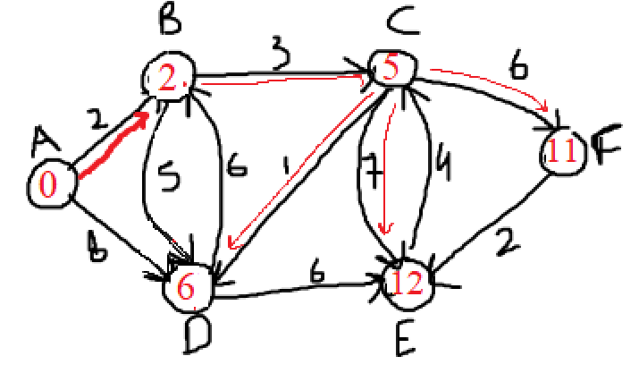
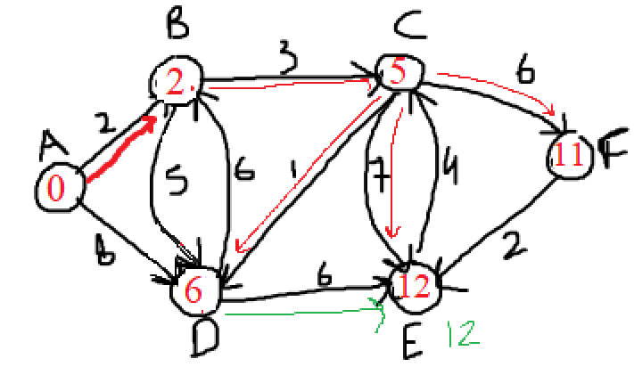
Shortest Path Algorithm
Priority queue → D E F
6 12 11
Solution set (S)= {A,B,C}
Extract min(Queue) = D S = S U {D}
= {A,B,C,D}
Priority queue → E F
12 11
Solution set (S)= {A,B,C,D}
Extract min(Queue) = F S = S U {F}
= {A,B,C,D,F}

Slide 70
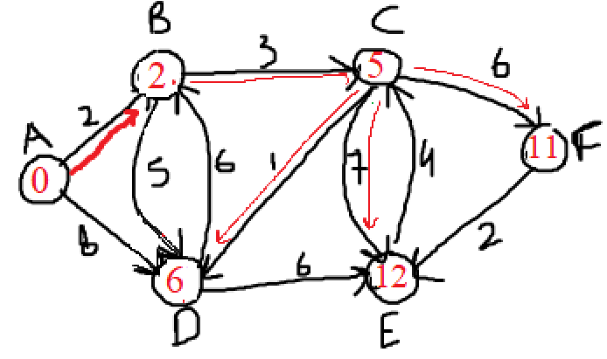
Shortest Path Algorithm
Priority queue → E
12
Solution set (S)= {A,B,C,D,F}
Extract min(Queue) = E S = S U {E}
= {A,B,C,D,F,E}
Source Distance From Source
A A B C D E F 0 2 5 6 12 11

Slide 71
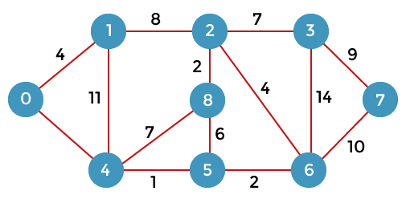
Dijkstra's Algorithm
Dijkstra's Algorithm
8
formula for calculating the distance between the vertices:
if( d(u) + c(u, v) < d(v)):
d(v) = d(u) +c(u, v)

Slide 72
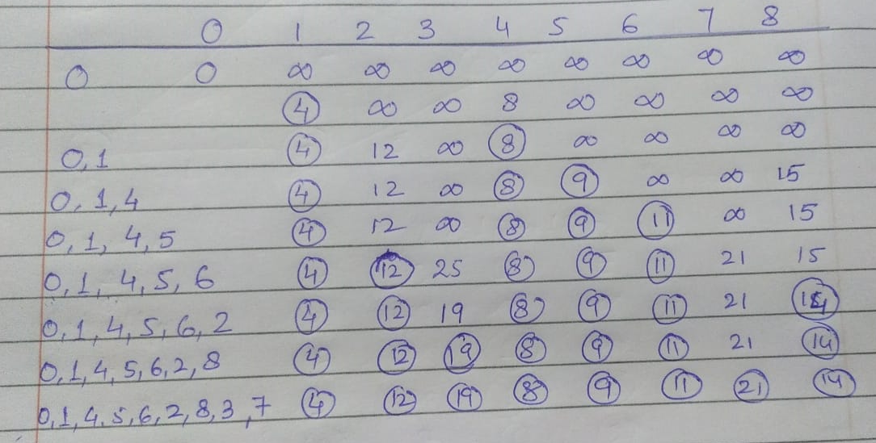
Dijkstra's Algorithm
Dijkstra's Algorithm

Slide 73
Dijkstra’s Algorithm
t
1
x
∞
∞
Find the single source shortest path from the
vertex S.
10
9
s
0
2
3
4
6
5
7
∞
∞
2
y
z

Slide 74
Dijkstra’s Algorithm
Find shortest path from s to t.
2
24
3
9
s
18
14
6
6
2
30
4
19
11
15
5
5
6
20
16
7
t
44

Slide 75
Dijkstra’s Pseudo Code
function dijkstra(V,E,W,S)
for each vertex v € V in G
d[V] <- infinite
d[S] <- 0
Q = V
S = NULL
while Q IS NOT EMPTY
u <- Extract MIN from Q
S = S U {u}
for each unvisited neighbour V of U
if d[V] > d[u]+w(u,v)
d[V] <- d[u] + w(u,v)

Slide 76
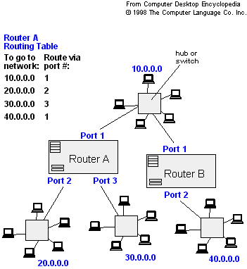
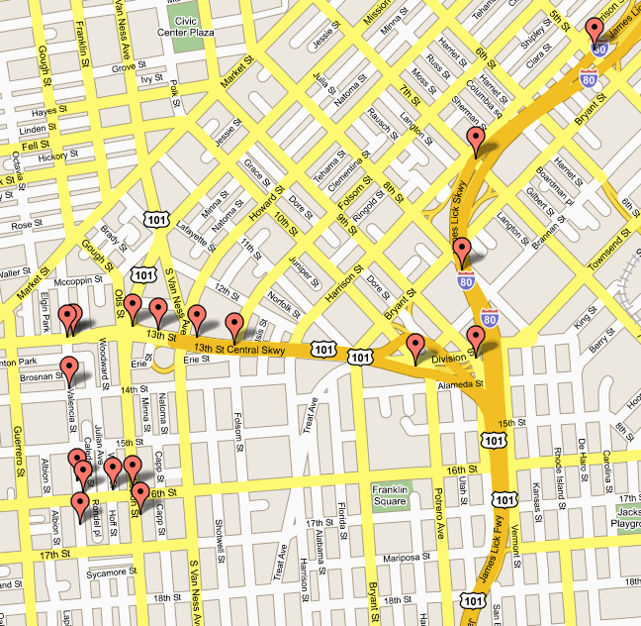
Applications of Dijkstra's Algorithm
- Traffic Information Systems are most prominent use
- Mapping (Map Quest, Google Maps)
- Routing Systems

Slide 77
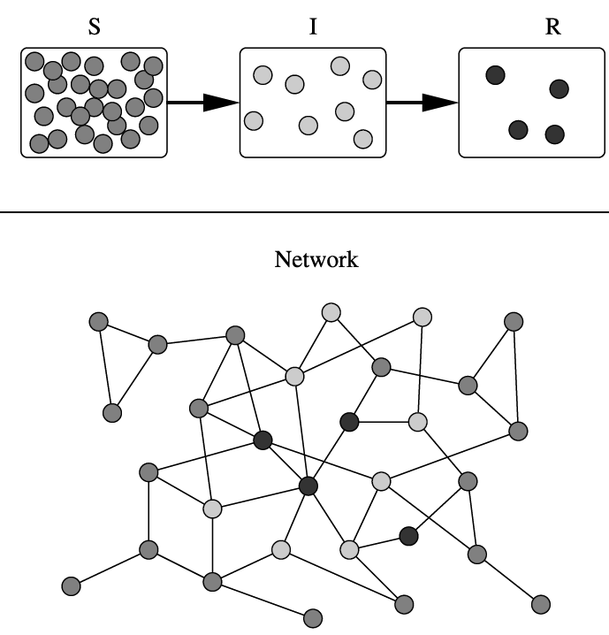
Applications of Dijkstra's Algorithm
One particularly relevant this week: epidemiology
Prof. Lauren Meyers (MIT, Biology Dept.) uses networks to model the spread of infectious diseases and design prevention and response strategies.

Slide 78
Applications of Dijkstra's Algorithm
Vertices represent individuals, and edges their possible contacts. It is useful to calculate how a particular individual is connected to others.
Knowing the shortest path lengths to other individuals can be a relevant indicator of the potential of a particular individual to infect others.

Slide 79
Floyd Warshall Algorithm-
Floyd Warshall Algorithm is a famous algorithm.
It is used to solve All Pairs Shortest Path Problem.
It computes the shortest path between every pair of vertices of the given graph.
Floyd Warshall Algorithm is an example of dynamic programming approach.

Slide 80
Floyd Warshall Algorithm-
Advantages-
Floyd Warshall Algorithm has the following main advantages-
It is extremely simple.
It is easy to implement.

Slide 81
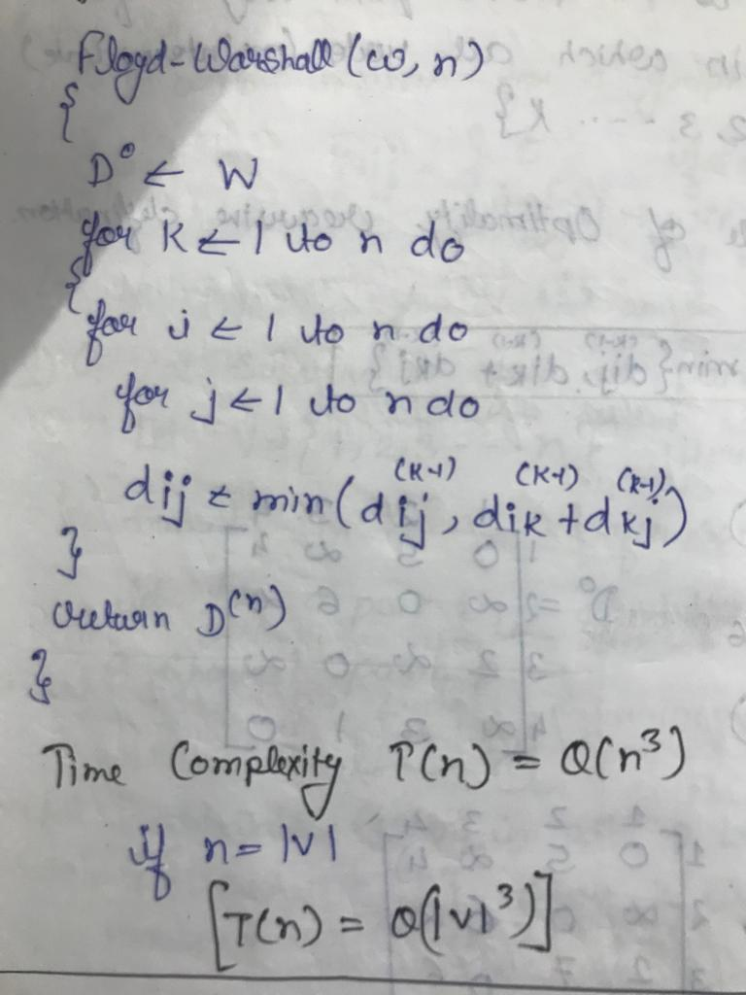
Floyd Warshall Algorithm-
Floyd Warshall Algorithm is as shown below-

Slide 82
Floyd Warshall Algorithm-
Time Complexity-
Floyd Warshall Algorithm consists of three loops over all the nodes.
The inner most loop consists of only constant complexity operations.
Hence, the asymptotic complexity of Floyd Warshall algorithm is O(n³).
Here, n is the number of nodes in the given graph.

Slide 83
Floyd Warshall Algorithm-
When Floyd Warshall Algorithm Is Used?
Floyd Warshall Algorithm is best suited for dense graphs.
This is because its complexity depends only on the number of vertices in the given graph.
For sparse graphs, Johnson’s Algorithm is more suitable.

Slide 84
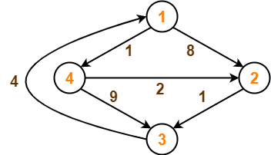
Floyd Warshall Problem
Problem-
Consider the following directed weighted graph-
Using Floyd Warshall Algorithm, find the shortest path distance between every pair of vertices.

Slide 85
Floyd Warshall Algorithm-
Solution-
Step-01:
Remove all the self loops and parallel edges (keeping the lowest weight edge) from the graph.
In the given graph, there are neither self edges nor parallel edges.
Step-02:
Write the initial distance matrix.
It represents the distance between every pair of vertices in the form of given weights.

Slide 86
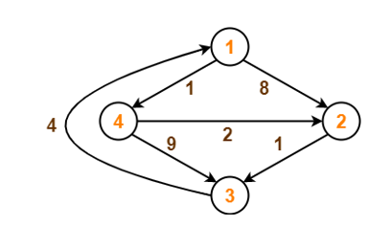
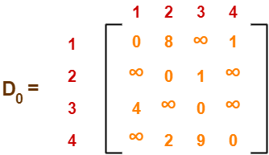
Floyd Warshall Algorithm-
Step-02: (Continue)
For diagonal elements (representing self-loops), distance value = 0.
For vertices having a direct edge between them, distance value = weight of that edge.
For vertices having no direct edge between them, distance value = ∞.
Initial distance matrix for the given graph is-

Slide 87
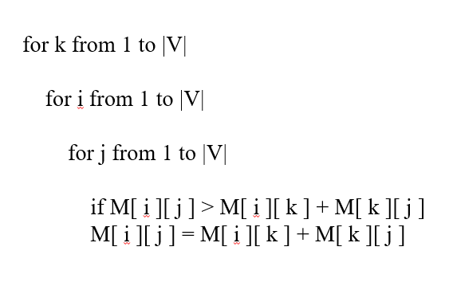
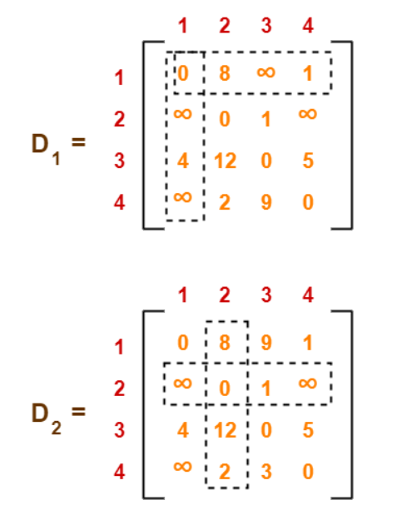
Floyd Warshall Algorithm-
Step-03:
Using Floyd Warshall Algorithm, write the following 4 matrices-

Slide 88
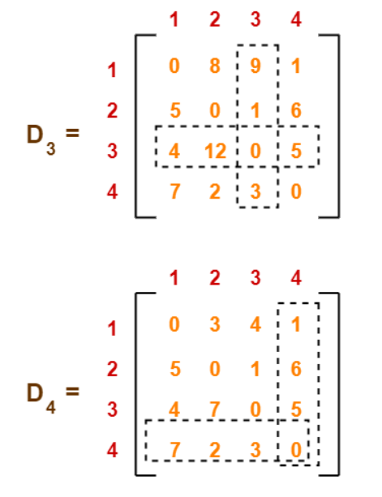
Floyd Warshall Algorithm-
Step-03:
The last matrix D₄ represents the shortest path distance between every pair of vertices.

Slide 89
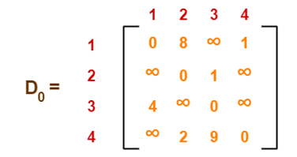
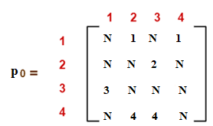
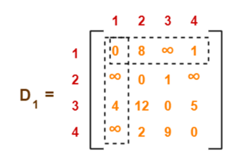
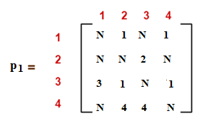
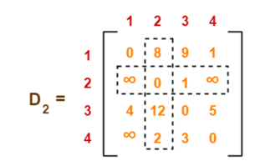
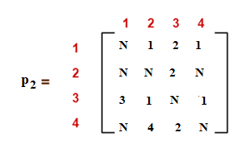
Floyd Warshall Algorithm-

Slide 90
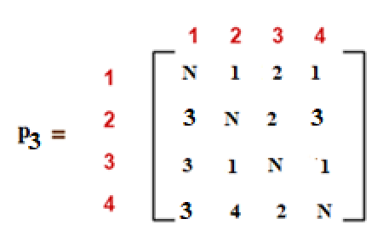



Floyd Warshall Algorithm-

Slide 91
Floyd Warshall Algorithm-

Slide 92
Floyd Warshall Algorithm-
Remember-
In the above problem, there are 4 vertices in the given graph.
So, there will be total 4 matrices of order 4 x 4 in the solution excluding the initial distance matrix.
Diagonal elements of each matrix will always be 0.

Slide 93
Transitive Closure of a Graph
Transitive Closure of a Graph
Given a directed graph, find out if a vertex j is reachable from another vertex i for all vertex pairs (i, j) in the given graph. Here reachable mean that there is a path from vertex i to j.
The reach-ability matrix is called the Transitive Closure of a Graph.
Transitive closure of graphs is
1 1 1 1
1 1 1 1
1 1 1 1
0 0 0 1

Slide 94
CHP - 9 File Structures
File Structure

Slide 95
INTRODUCTION
In some of the previous chapters, we have discussed representations of and operations on data structures.
These representations and operations are applicable to data items stored in main memory.
However, not always the data is available in main memory.
This is because of two main reasons. First, there may be a program whose size is larger than the available
memory or there may be a program, which requires data that cannot fit in main memory at once.
Second, main memory loses the data once the program is terminated or the power supply is switched off and it may be required to store data from one execution of a program to next.
For these reasons, data should be stored on some external memory. The place that usually holds the data is a file on the disk.

Slide 96
CONCEPTS OF FIELDS, RECGRDS AND FILES
Field: It is a smallest unit to store data, also known as attribute or column. A field has two properties; namely, type and size. Type specifies the data type and size specifies the capacity of the field to store data. For example, address can be of type character with some size in number of characters.
Record: It is a collection of related fields, also known as tuple or row. For example, an employee record may consist of fields Employeeld, Name, Address, City etc.
File: It is a set of related records, also known as relation or table. A file is identified by properties like file name, size and location. File can be text file or binary file. Text file stores numbers as a sequence of characters, whereas, a binary file stores numbers in binary format. A file can contain any number of records. For example, a file containing records of employees in an organization.

Slide 97
CONCEPTS OF FIELDS, RECGRDS AND FILES
File Organization: A file has two facets; logical and physical. A logical file is a set of records, whereas, physical fife shows how records are physically stored on the disk. File organization refers to the physical representation of a file.
Key: It is an attribute that uniquely identifies the records of a file. It contains unique values to which can be used to distinguish one record from another in a file. For example,the field Employee ld can be taken as key for employee file, which can be used to distinguish one record from another.
Page: A file is loaded in the main memory to perform operations like insertion, modification, deletion, etc., on it. If the file is too large in size, it is decomposed into equal size pages, which is the unit of exchange between the disk and the main memory.
Index: It is a pointer to a record in a file, which provides efficient and fast access to records.

Slide 98

ORGANIZATION OF RECORDS IN FILE
Fixed-Length Records
All the records in a file of fixed-length record are of same length. In a file of fixed-length records, every record consists of same number of fields and size of each field is fixed for every record. It ensures easy location of field values, as their positions are predetermined.
Since each record occupies equal memory, as shown in Figure 9.1, identifying start and end of record is relatively simple.

Slide 99
Fixed-Length Records
A major drawback of fixed-length records is that a lot of memory space is wasted.
Since a record may contain some optional fields and space is reserved for optional fields as well-it stores null value if no value is supplied by the user for that field.
Thus, if certain records do not have values for all the fields, memory space is wasted. In addition,it is difficult to delete a record as deletion of a record leaves blank space in between the two records. To fill up that blank space, all the records following the deleted record need to be shifted.
It is undesirable to shift a large number of records to fill up the space freed by a deleted record, since it requires additional disk access. Alternatively, the space can be reused by placing a new record at the time of insertion of new records, since insertions tend to be more frequent.

Slide 100

Fixed-Length Records
However, there must be some way to mark the deleted records so that they can be ignored, during the file scan.
In addition to simple marker on deleted record, some additional structure is needed to keep track of free space created by deleted or marked records. Thus, certain number of bytes is reserved in the beginning of the file for a file header.
The file header stores the address of first marked record, which further points to second marked record and so on. As a result, a linked list of marked slot is formed, which is commonly termed as free list.
Figure ,9.2 shows the record of a file with file header pointing to first marked record and so on.

Slide 101


Variable-Length Records
Variable-length records may be used to utilize memory more efficiently. In this approach, the exact length offield is not fixed in advance. Thus, to determine the start and end of each field within the record, special separator characters, which do not appear anywhere within the field value, are required (see Figure 9.3). Locating any field within the record requires scan of record until the field is found.
Alternatively, an array of integer offset could be used to indicate the starting address of fields within a record. The ith element of this array is the starting address of the ith field value relative to the start of the record. An offset to the end of record is also stored in this array, .which is used to recognize the end of last field. The organization is shown in Figure 9.4. For null value, the pointer to starting and end of field is set same. That is, no space is used to represent a null value. This technique is more efficient way to organize the variable-length records. Handling such an offset array is an extra overhead; however, it facilitates direct access to any field of the record.

Slide 102
FILE ORGANIZATION
Arrangement of the records in a file plays a significant role in accessing them. Moreover, proper organization of files on disk helps in accessing the file records efficiently.
There are various methods (known as file organization) of organizing the records in a file while storing a file on disk.
Sequential File Organization
Random File Organization
Indexed Sequential File Organization
Multi-key File Organization and Access Methods

Slide 103
Sequential File Organization
Often, it is required to process the records of a file in the sorted order based on the value of one of its field. If the records of the file are not physically placed in the required order, it consumes time to fulfill this request.
However, if the records of that file are placed in the sorted order based on that field, we would be able to efficiently fulfill this request.
file organization in which records are sorted based on the value of one of its field is called sequential file organization and such a file is called sequential file.
In a sequential file, the field on which the records are sorted is called ordered field.
This field mayor may not be the key field. In case, the file is ordered on the basis of key, then the field is called the ordering key.

Slide 104
Random File Organization
Unlike sequential file, records in this file organization are not stored sequentially.
Instead, each record is mapped to an address on disk on the basis of its key value. One such technique for this mapping of record to an address is called hashing.

Slide 105

Indexed Sequential File Organization
The indexed sequential file organization provides the benefits of both the sequential and random file organization methods.
Structure of Index File:
index file has two fields-one stores the key value and contains a pointer to the record in the original file.
To understand this, consider the file shown in Figure 9.6, which contains information about the various books. Now if an index is created on the field Book_Id, the index file will be as shown in Figure 9.7.

Slide 106
Multi-key File Organization and Access Methods
So far we have discussed the file organization methods that allow -records to be accessed based on a single key. There might be a situation where it is desirable or even necessary to access the records on anyone of the number of keys.
For example, consider Book file shown in Figure 9.6. Different users may need to access the records of this file in different way. Some users may need accessing the record based on the field Book _Id, others may need accessing the record based on the field Category.
To implement such searches, .the idea of indexing can be generalized and a similar index may be defined on any field of resulting in a multi-key file organization.
There are two main techniques used to implement multi-key file organization, namely, multi-lists and inverted-lists.

Slide 107

Multi-lists
In a multi-lists organization, indexes are defined on the multiple fields that are frequently used to search the record.
A multi-list structure of the file shown in Figure 9.6 is given in Figure 9.8. Here, one index has been defined on the field Book Id and another on Category.

Slide 108

Inverted List
Like multi-lists structure, inverted list structures can also maintain multiple indexes on the file.
The only difference is that instead of maintaining pointers in each record as in multi-lists, indexes in the inverted file maintain multiple pointers to point to the records.
Indexes on Book_ Id and Category field for inverted file are shown in Figure 9.9.

Slide 109
Faculty Video Links, Youtube & NPTEL Video Links and Online Courses Details
Self Made Video Link:
YouTube/other Video Links
https://www.youtube.com/watch?v=eujc7_0FhCI
https://www.youtube.com/watch?v=gXgEDyodOJU

Slide 110
Daily Quiz
Prove that, if there exists negative edge, dijkstra’s shortest path algorithm may fail to find the shortest path
How you can find number of shortest paths from source to destination using Dijkstra’s algorithm?
Suppose you are given a graph where each edge represents the path cost and each vertex has also a cost which represents that, if you select a path using this node, the cost will be added with the path cost. How can it be solved using Dijkstra’s algorithm?
Write the algorithm of Floyd Warshal all pair shortest path.
Write the algorithm for prims and Kruskal.
What do you mean by minimum spanning tree.
Define adjacency list and adjacency matrix.
Write the applications of graph.

Slide 111
Weekly Assignment
Q.1 Draw the complete undirected graphs on one, two, three, four and five vertices. Prove that the number of edges in an n vertex complete graph is
n ( n -1)/2.
Q.2 What are the different ways of representing a graph? Represent the following
graph using those ways.
Q.3 What are the different ways of representing a graph? Represent the following
graph using those ways.

Slide 112
Weekly Assignment
Q.4 Write an algorithm which does depth first search through an un-weighted
connected graph. In an un-weighted graph, would breadth first search or depth
first search or neither find a shortest path tree from some node? Why?
Q.5 Which are the two standard ways of traversing a graph? Explain them with an example of each.
Q.6 Explain Dijkstra’s algorithm for finding the shortest path in a given graph.
Q.7 Write the short note on Tree Traversal.

Slide 113
MCQ s
Which of the following algorithms can be used to most efficiently determine the presence of a cycle in a given graph ?
a. Depth First Search
b. Breadth First Search
c. Prim's Minimum Spanning Tree Algorithm
d. Kruskal' Minimum Spanning Tree Algorithm
2. Traversal of a graph is different from tree because
a. There can be a loop in graph so we must maintain a visited flag for every vertex
b. DFS of a graph uses stack, but in-order traversal of a tree is recursive
c. BFS of a graph uses queue, but a time efficient BFS of a tree is recursive.
d. All of above

Slide 114

MCQ s
3. What are the appropriate data structures for following algorithms?
Breadth First Search
Depth First Search
Prim's Minimum Spanning Tree
Kruskal' Minimum Spanning Tree
4. The Breadth First Search algorithm has been implemented using the queue data structure. One possible order of visiting the nodes of the following graph is

Slide 115

MCQ s
5. Consider the following graph,
Among the following sequences:
(I) a b e g h f
(II) a b f e h g
(III) a b f h g e
(IV) a f g h b e
Which are depth first traversals of the above graph?
6. Given two vertices in a graph s and t, which of the two traversals (BFS and DFS) can be used to find if there is path from s to t?
Only BFS
Only DFS
Both BFS and DFS
Neither BFS nor DFS

Slide 116
MCQ s
7. Which of the following is the most commonly used data structure for implementing Dijkstra's Algorithm?
a. Max priority queue
b. Stack
c. Circular queue
d. Min priority queue
8. What is the time complexity of Dijikstra's algorithm?
a. O(N)
b. O(N3)
c. O(N2)
d. O(logN)

Slide 117
MCQ s
9. Which of the following condition is sufficient to detect cycle in a directed graph?
a. There is an edge from currently being visited node to an already visited node.
b. There is an edge from currently being visited node to an ancestor of currently visited node in DFS forest.
c. Every node is seen twice in DFS.
d. None of the above
10. Dijkstra's Algorithm is used to solve ..... problems.
a. All pair shortest path
b. Single source shortest path
c. Network flow
d. Sorting

Slide 118
Expected Questions for University Exam
Define graph. How a graph is different from a tree?
Write Dijkastra algorithm for finding the shortest path from a source vertex.
Write the algorithm of floyd warshall. Also explain it with example.
Define connected graph and complete graph with example.
How the graph can be represented in memory? Explain with suitable example.
Explain Depth First Search Traversal in Graph with the help of an example.

Slide 119
Expected Questions for University Exam
7. Define Floyd Warshall Algorithm for all pair shortest path and apply the same on following graph:
8. Considering ‘S’ as source vertex, Apply the Dijkstra’s shortest path algorithm on the following graph:

Slide 120
Old Question Papers
https://drive.google.com/open?id=15fAkaWQ5ccZRZPzwlP4PBh1LxcPp4VAd

Slide 121
Summary
Graph theory is an exceptionally rich area for programmers and designers.
Graphs can be used to solve some very complex problems, such as least cost routing, mapping, program analysis, and so on.
Network devices, such as routers and switches, use graphs to calculate optimal routing for traffic.

Slide 122
References
[1] Aaron M. Tenenbaum, Yedidyah Langsam and Moshe J. Augenstein, “Data Structures Using C and C++”, PHI Learning Private Limited, Delhi India
[2] Horowitz and Sahani, “Fundamentals of Data Structures”, Galgotia Publications Pvt Ltd Delhi India.
[3] Lipschutz, “Data Structures” Schaum’s Outline Series, Tata McGraw-hill Education (India) Pvt. Ltd.
[4] Thareja, “Data Structure Using C” Oxford Higher Education.
[5] AK Sharma, “Data Structure Using C”, Pearson Education India.

Slide 123
Thank you

